Slide 1
The Art of Data Visualization: Analysing each component of The building

Slide 2
Table of contents: 1) Introduction 2) Loading the dataset 3) Handling missing values and removing duplicates 4) Feature Engineering 5)Univariate Analysis 6)Bivariate Analysis 7) Multivariate Analysis 8) Conclusion For checking the dimensions of the dataset we use shape method. new_dataset.shape 2) Getting the statistical information about the dataset: For getting the statistical information about the dataset we use describe method and also we use info method for get the information of memory usage, datatypes , null values are there are not like that. new_dataset.describe() new_dataset.info()

Slide 3
Introduction Every middle class person has a dream to buy a house, but they are worrying about how much the house costs and also in their mind there will be some specifications and they are thinking about when they add those specifications how much a house costs . In this project we are going to analyze each component of a building and how those components are impacting the building cost.

Slide 4
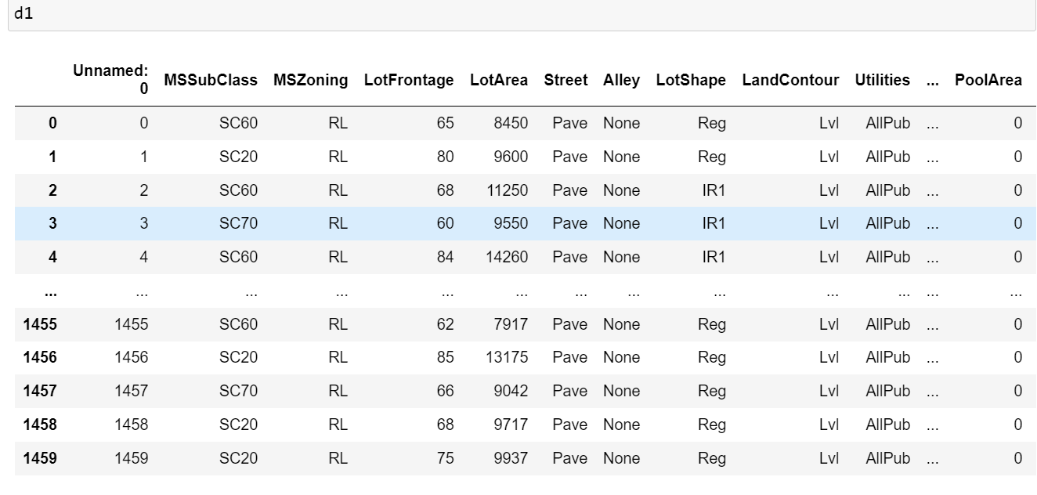
Importing the datasets 1) Importing the dataset: a) to import the data set first we have to import pandas. import pandas as pd b) now by using read_csv we have to import he data set by giving the path in pd.read_csv. pd.read_csv(“housing_data (1).csv”)

Slide 5
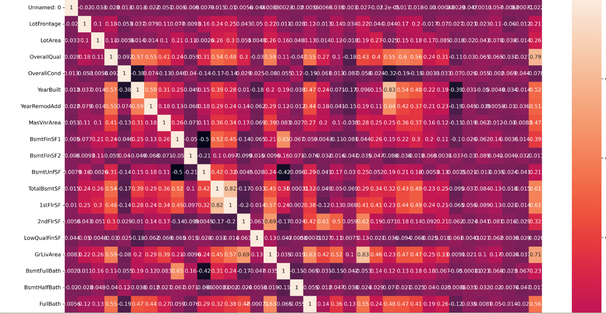
Dropping unnecessary columns 1) Dropping unnecessary columns: 1.a) Dropping Numeric columns: For that we have find the correlation the values range between -0.1 to +0.1 , remove those columns. This correlation is taken to Sale Price to remaning all columns.

Slide 6
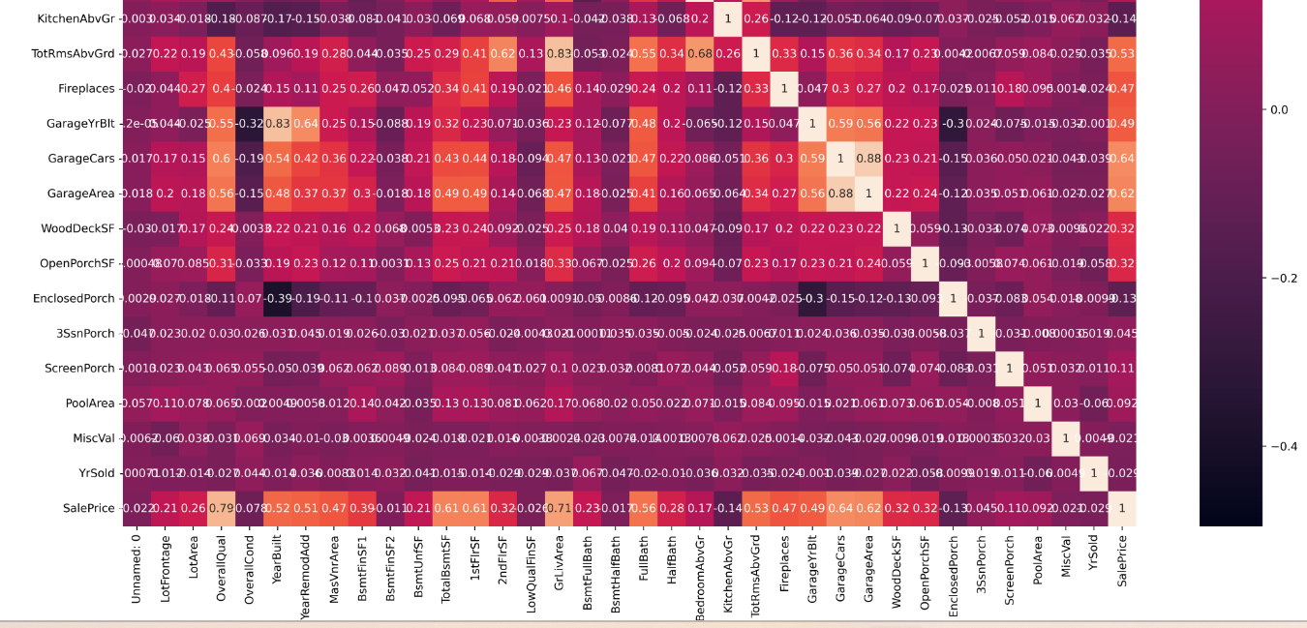
Dropping Categorical columns: 1) For dropping the categorical columns first we have to check the categorical columns that we have for that we use. D1.info() 2) After getting the Categorical columns we have to change them into numeric columns for that we have to use label encoder and then find the correlation of Sales Price to remain all columns and then remove the values which will have the correlation -0.1 to +0.1

Slide 7
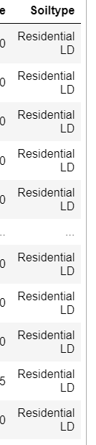
Feature Engineering: 1) If we see in the dataset so many values are with short abbreviation which we cannot be understood while during analysis. 2) For that reason now we are going to create a new column with full abbreviation and then we can do the label encoding. #Feature engineering d4['Soiltype']=d4['MSZoning'].replace(['RL', 'RM', 'C (all)', 'FV', 'RH'],['Residential LD','Residential MD','Commercial','Floating VR','Residential HD’]) The above code tells us the MSZoning has been replaced with Soiltype.

Slide 8
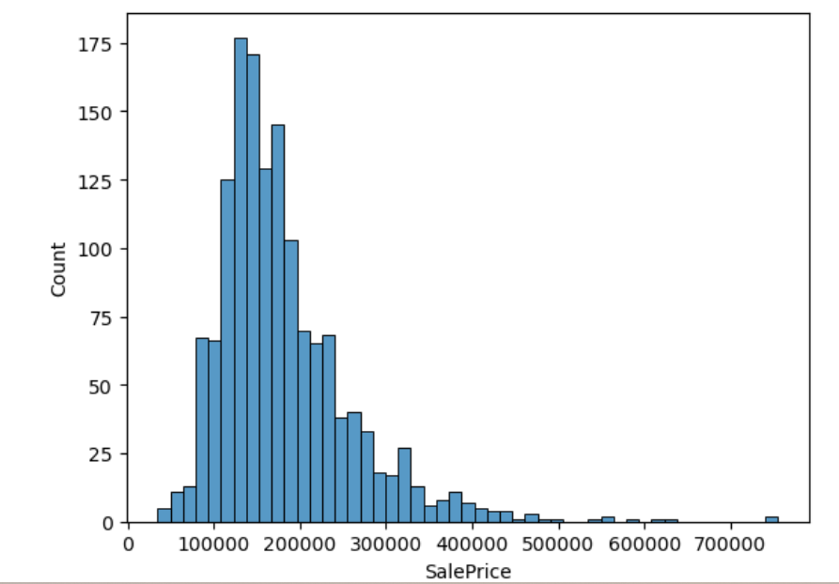
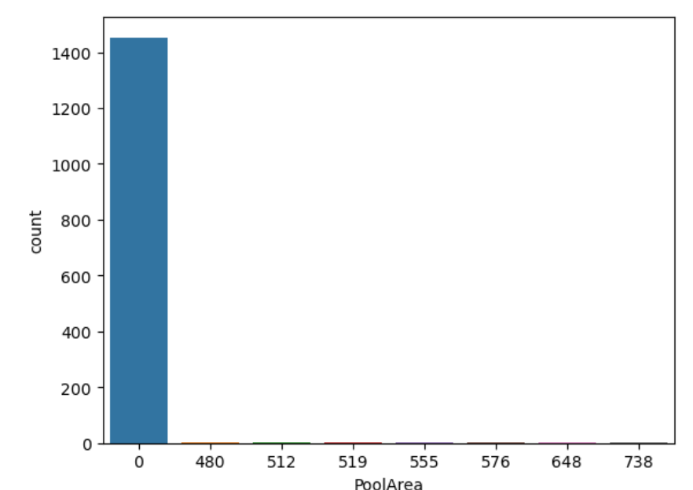
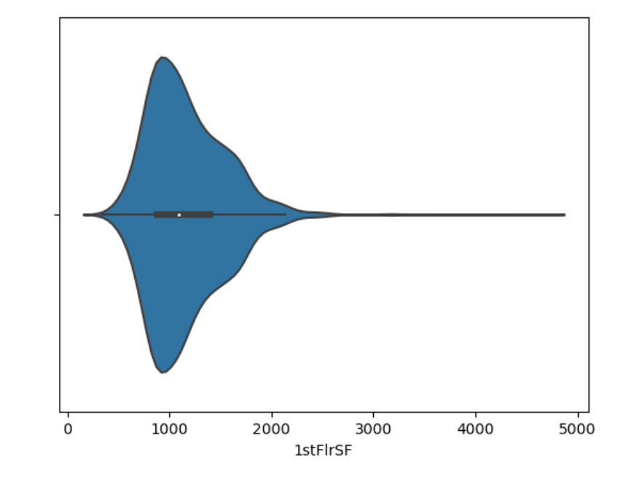
Univariate Analysis 1) Identifying the unique values: For get the unique values in the In this Univariate analysis we have been used count plot and violin plot, hist plot, If we see the first diagram it tells how that most of the values price between 100000 to 350000, In second diagram tells so many flats does not have any pool area and the 3rd diagram tells us for most of the flats have the 1000 square feet in the 1st floor.

Slide 9
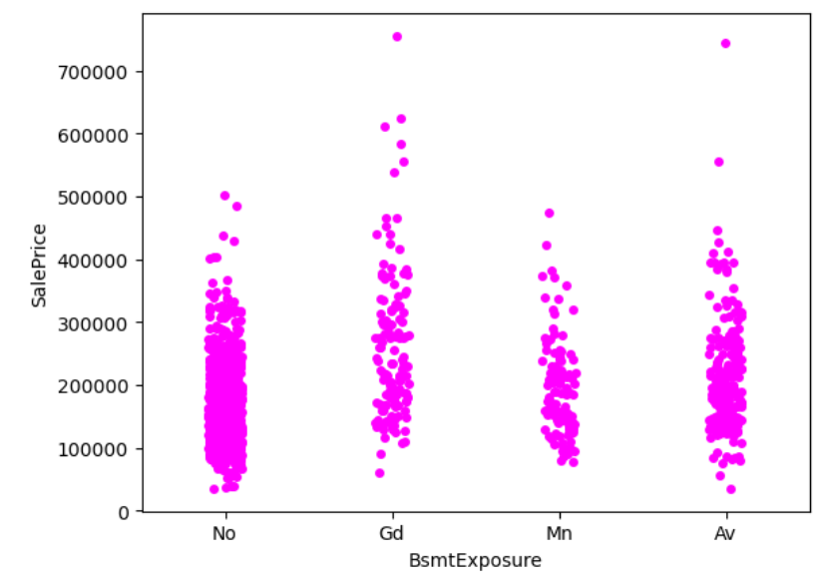
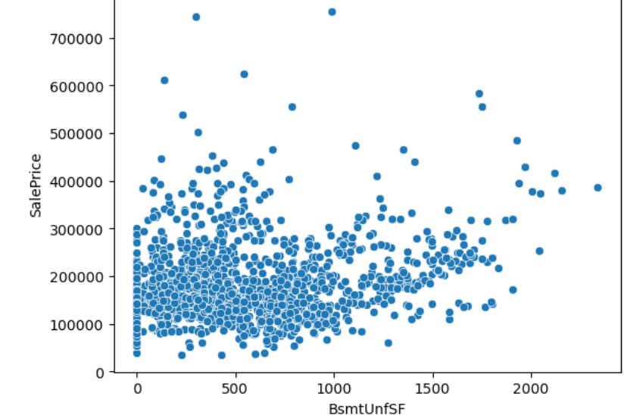
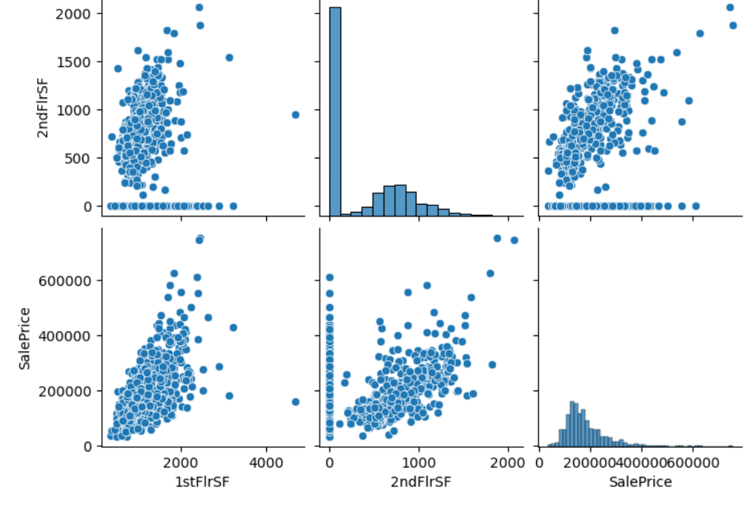
Bivariate Analysis In this Bivariate analysis we have been used Strip plot, Scatter plot, Pair plot. If we see the first diagram it garden-level walls are good exposure then the sales price is high., In second diagram tells most of the basement of the flats are not finisheddand the 3rd diagram tells most of the square feet between 500 to 2000 has 2nd floor and the area has square feet of 1900 have high sales price.

Slide 10
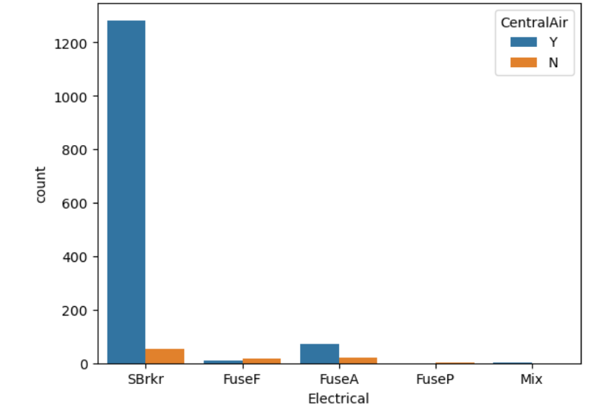
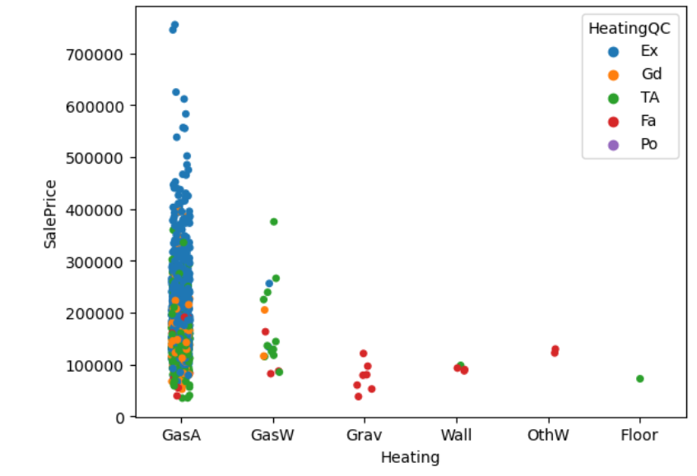
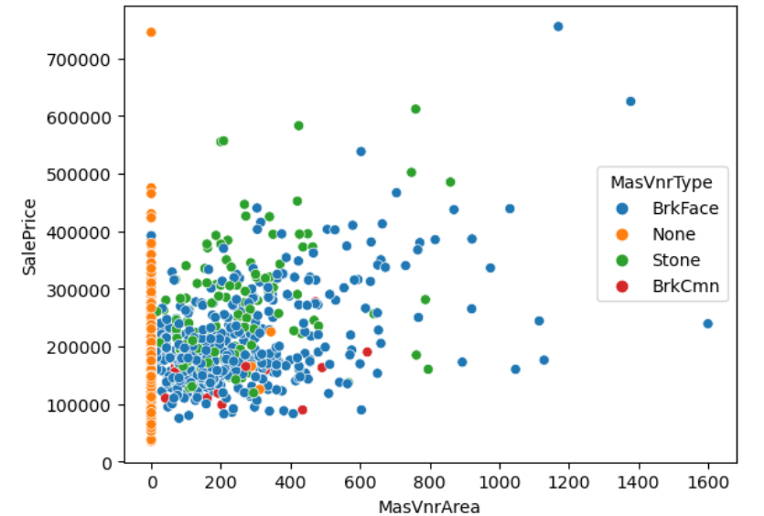
Multivariate Analysis In this Multivariate analysis we have been used Strip plot, Scatter plot, Count plot. If we see the first diagram most of the flats have the central air condition with the circuit type as Standard Circuit Breakers & Romex ., In second diagram tells when the gas condition is excellent then the sales price is high and also most of the flats has the Gas forced warm air furnace as gas type. and the 3rd diagram tells when masonry veneer is brick face then also the sales price is high.

Slide 11
Conclusion k 1) When you want the flat which will have Soiltype has Residential Low density, House Style is 2Story, garage is attached to flat, garage area between 500 to 1000, 1st floor square feet between 500 to 2000 which has 2nd floor and the area has square feet of 1900, kitchen quality is excellent , basement finished area is good living quarters, walkout or garden-level walls are good exposure, living area between 3000 to 4000 sqft, which will have 4 bedrooms, if they have one half both room or 4 full bathrooms then the flat is above 7,00,000. 2) When you want the flat which will have Soiltype has Floating village residential, House Style is 1Story, garage is built-in , garage area between 500 to 1000, 1st floor square feet between 500 to 2000 which has 2nd floor and the area has square feet of 500 , kitchen quality is Good , basement finished area is Average living quarters, walkout or garden-level walls are Average exposure, living area between 1500to 3000sqft , which will have 2 bedrooms, if they have one half both room or 2 full bathrooms then the flat is between 3,00,00 to 7,00,000. 3) When you want the flat which will have Soiltype has Commercial House Style is Two and one-half story, garage is carport, garage area between 700 to 750, 1st floor square feet between 500 to 2000 which has no 2nd floor , kitchen quality is Average , basement finished area is Average Rec Room, living area below 1500sqft, which will have 1 bedrooms, if they have one half both room or 1 full bathrooms then the flat is below 3 lakhs.

Slide 12
Thank You!

